Slide 1
There are 3 types of rotation for Large Motor in EV3:
+Turn motor through a given angle
+Turn motor for a given time
+Turn motor 'forever'

Slide 2
Important to remember
DO NOT SET THE SPEED OF THE ROBOT TO OVER 900 OR -900

Slide 3
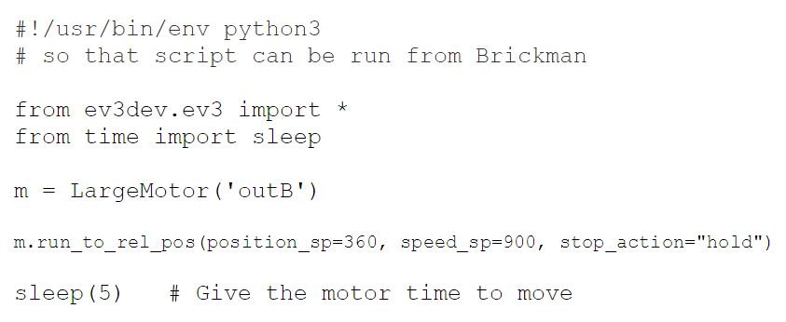
Turn motor through a given angle

Slide 4
Exericise 1:
Step 1: Make the robot go forward and rotate 720 degrees.
Step 2: Make the robot go backwards using -720 degrees
Step 3: Does the robot go backwards if you set speed_sp to a negative value and position_sp set to a positive value?

Slide 5
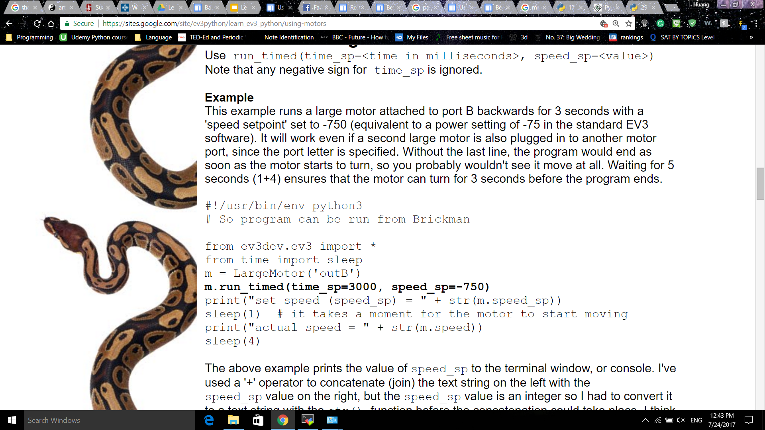
Turn motor for a given time

Slide 6
Exercise 2:
Step 1: Make the robot go forwards for 3 seconds and then go backwards for 2 seconds.
Step 2: Run the program from the command line (lift the robot up) and print out the actual speed of the robot (m.speed).
Step 3: What happens if time_sp is a negative value?

Slide 7
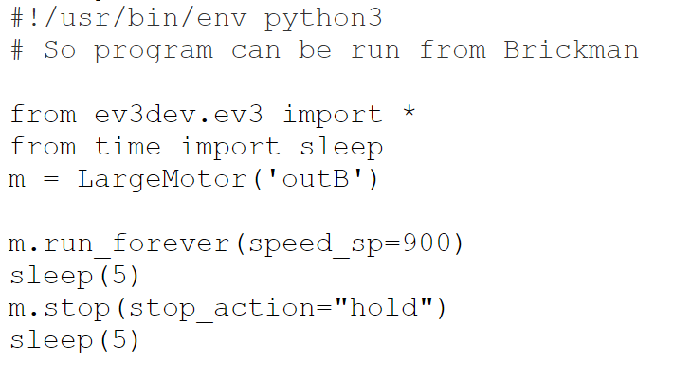
Turn motor ‘forever’

Slide 8
Exercise 3:
Step 1: Make the robot go straight using run_forever function for 3 seconds and stop for 1 second. Then go backwards for 3 seconds and stop.
Step 2: How many types do stop_action have? What are they? Hint: similar to Mindstorm
Step 3: Implement different stop_action

Slide 9
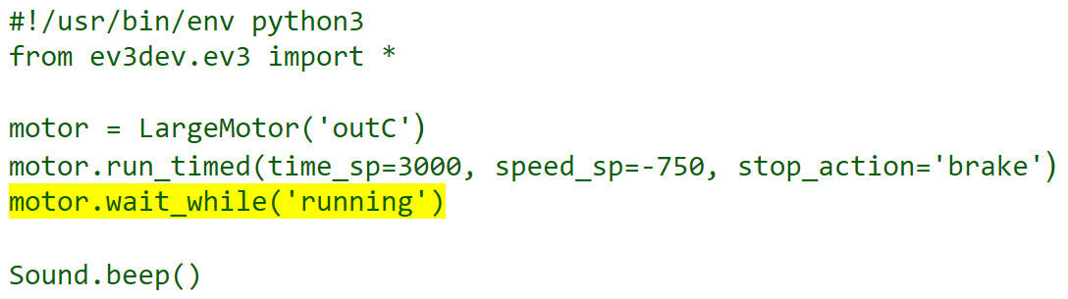
Wait for completion

Slide 10
Exercise 4:
Make the robot turn left 90 degrees. Then go straight for 2 seconds and turn right 90 degrees. Then finish the program with sys.exit().

